Slide 1
ES6 & It’s Features
23 July 2018

Slide 2
Agenda
What is ES6
Features of ES6
Demonstration of ES6 features.
References
Questions

Slide 3
What is ES6 ?
1995: JavaScript was created by Brendan Eich in 1995 at Netscape Communications. Initially named as Mocha, LiveScript , finally JavaScript.
ECMAScript(ES) : Scripting Language specification standardized by ECMA international .(European Computers Manufacturers Association)
JScript : is Microsoft's name of their own implementation.
1996: ECMA Adopts JavaScript
1998: ECMAScript 2
1999: ECMAScript 3 (regex, try/Catch)
2005: ECMAScript 4 (Ajax)
2009: ECMAScript 5(Major Changes – JSON)
2015: ECMAScript 6 (ES6)(Currently in use)

Slide 4
Features of ES6:
From var to let/const.
Arrow functions
Default parameter values
Rest / Spread operator
String interpolation
Multi line Strings in ES6
Property Shorthand
Class definition / class inheritance
Built in Data – Structures
Array Helper Methods
Destructing Assignments
Promises in ES6
Proxies
Other Features

Slide 5
1: From var to let/const.
var :
Scoped to the nearest function block
If accesssed before Declaration , will give undefined
Loose redeclaration.
let :
Scoped to nearest enclosing block
Can not be accessed before declaration , will give Uncaught ReferenceError
Stricr redeclaratuon .
Const :
Immutable reference.
Demo in notes
Notes:
Please run following Script for demo
<script>
function varExample() {
var e1 = 1;
{
var e2 = 2;
}
console.log(e1 +' '+ e2);
}
function letExample() {
let e1 = 1;
{
let e2=2;
}
console.log(e1 +' '+ e2);
}
function varExample2() {
var e1 = 1;
var e1 = 45;
console.log(e1);
}
function letExample2() {
let e1 = 1;
let e1 = 45;
console.log(e1);
}
function varExample3() {
console.log(e1);
var e1 = 45;
console.log(e1);
}
function letExample3() {
console.log(e1);
let e1 = 45;
console.log(e1);
}
letExample3();
</script>

Slide 6
2:Arrow Functions / 3.Default parameter values.
1: With Params
var multiplyES5 = function(x, y) { return x * y; };
const multiplyES6 = (x, y) => x * y ;
2: Object Literal Syntax
var setNameIdsEs5 = function setNameIds(id, name) { return { id: id, name: name }; };
var setNameIdsEs6 = (id, name) => ({ id: id, name: name });
3: Default parameter values:
Default parameters allow us to initialize functions with default values.
A default is used when an argument is either omitted or undefined — meaning null is a valid value.
A default parameter can be anything from a number to another function.
function multiply (a, b = 2) { return a * b; } multiply(5);

Slide 7
4: Spread operator
… (three dots)
Generally used to split an array into a list of comma-separated values which can be used in various places such as function arguments or array matching.
Rest operator : to collect the a comma separated array of inputs into one variable :
const addNumbers = (...numbers) => numbers.reduce((sum,number) => {
return sum + number;
}, 0);
console.log(addNumbers(3,4,5,6,7,8,9));
Spread operator : Opposite of Rest operator .
let obj1 = { a: 1, b: 2, c: 3};
let obj2 = { p: 4, q: 5, r: 6};
let obj3 = { ...obj1, ...obj2};
console.log(obj3); // All elements of ob1 & obj2
Demo in notes
Notes:
<script>
const addNumbers = (...numbers) => numbers.reduce((sum,number) => {
return sum + number;
}, 0);
console.log(addNumbers(3,4,5,6,7,8,9));
let obj1 = { a: 1, b: 2, c: 3};
let obj2 = { p: 4, q: 5, r: 6};
let obj3 = {
...obj1,
...obj2
};
console.log(obj3);
const colors1 = ['red','green'];
const colors2 = ['orange','yellow'];
const colors3 = ['white','black'];
const concatColors = ['newColor',...colors1,...colors2,...colors3];
console.log(concatColors);
</script>

Slide 8
5: String Interpolation USING Template Literals
ES5:
var something = ‘ES6’;
var str = ‘This is a good time to learn’+xyz+’ this summer’;
ES6:
let something = ‘ES6’;
let str = `This is a good time to learn ${something} this summer`;
Nested Strings :
ES5:
"This is a \"nested string\".“
or
'This is also a \'nested string\'.‘
// or
"This is another 'nested string'.“
ES6:
`This is a "nested string".`

Slide 9
6: Multiline Strings
ES5:
console.log('Line 1 \n' +
'Line 2 \n' +
'Line 3' );
ES6:
console.log(`Line 1
Line 2
Line 3`);
Enter key is interpreted by ES6 in string literals using backticks.
Demo in notes
Notes:
<script>
let something = 'ES6';
let str = `This is a good time to learn ${something} this summer`;
console.log(str);
console.log('Line 1 \n' +
'Line 2 \n' +
'Line 3' );
console.log(`Line 1
Line 2
Line 3`);
</script>

Slide 10
7: Property Shorthand
ES 6 provides a concise form for defining object literal methods and properties.
Need not to write key : value pair syntax if key and value are same string literals in JSON formation :
ES5:
function createObject(type, name, year, model, price) { return {
type: type,
name: name,
year: year,
model: model,
price: price
};}
ES6:
const createObject = (type, name, year, model, price) => { return {
type,
name,
year,
model,
price
}
}
Demo in notes
Notes:
<script>
function createObject(type, name, year, model, price) { return {
type: type,
name: name,
year: year,
model: model,
price: price
};}
const createObject = (type, name, year, model, price) => { return {
type,
name,
year,
model,
price
}
}
console.log(createObject('Car','BMW','2018','X1','3000000'));
</script>

Slide 11
8: Classes
ES5:
Classes were built by prototypes.
Lot of boiler plate code to write a class, its properties and behaviors.
Inheritance was done by prototype constructors.
ES6:
Object oriented class structures.
Easy declaration of Classes, methods,
Easy inheritance.
Demo in notes
Notes:
<script>
function Car(options) {
this.car = options.title;
}
Car.prototype.drive = function () {
return 'drive';
}
var car = new Car({title : 'General Car'});
console.log(car.drive());
console.log(car);
function Toyota(options) {
Car.call(this,options)
this.color = options.color;
}
Toyota.prototype = Object.create(Car.prototype);
Toyota.prototype.constructor = Toyota;
Toyota.prototype.honk = function() {
return 'beep';
}
var toyota = new Toyota({color: 'red', title : 'Totoya Ennova'})
console.log(toyota);
console.log(toyota.drive());console.log(toyota.honk());
</script>
<script>
class Car {
constructor({title}) {
this.title = title
}
drive() {
return 'General Car Drive';
}
}
const car = new Car({ title : 'General Car'});
console.log(car);
console.log(car.drive());
class Toyota extends Car{
constructor(options) {
super(options);
this.color = options.color
}
honk() {
return 'beep';
}
}
const toyota = new Toyota({color: 'red', title: 'Toyota'});
console.log(toyota);
console.log(toyota.honk());
console.log(toyota.drive());
</script>

Slide 12
9: Built in data Structures
1: Built in Map
let map = new Map();
map.set('foo', 123);
map.get('foo')
map.has('foo')
let map = new Map([ key, valuepairs ]);
let map = new Map() .set(1, 'one') .set(2, 'two') .set(3, 'three');
Iterators : map.keys() , map.values(), map.entries();
2: Built in Set
let set = new Set();set.add(1); set.add('1'); set.add({ key: 'value' });
let set = new Set([ object array]);
set.has(object);
set.delete(object);
Set.clear();

Slide 13
10: Array Helper Methods
1: ForEach Helper
ES5:
var colors = ['red','blue','green'];
for(var i = 0; i < colors.length; i++){
console.log(colors[i]);
}
ES6:
colors.forEach( color => console.log(color))
2: Map Helper
ES5:
var numbers = [1,2,3,4,5];
var doubledNumbers = [];
for(var i = 0; i < numbers.length; i++){ doubledNumbers.push(numbers[i]*2); }
console.log(doubledNumbers);
ES6:
const doubled = numbers.map( (number,index) => {console.log(index); return number*2})
console.log(doubled);
Demo in notes
Notes:
<script>
var colors = ['red','blue','green'];
for(var i = 0; i < colors.length; i++){
console.log(colors[i]);
}
colors.forEach( color => console.log(color))
var numbers = [1,2,3,4,5];
var doubledNumbers = [];
for(var i = 0; i < numbers.length; i++){
doubledNumbers.push(numbers[i]*2);
}
console.log(doubledNumbers);
const doubled = numbers.map( (number,index) => {console.log(index); return number*2})
console.log(doubled);
</script>

Slide 14
10: Array Helper Methods …
3: filter Helper
const products = [
{name : 'cucumber', type: 'veg', price: 2, quantity : 0},
{name : 'banana', type: 'fruit', price: 15, quantity : 11},
{name : 'celery', type: 'veg', price: 12, quantity : 30},
{name : 'orange', type: 'fruit', price: 5, quantity : 3}
];
const filteredProducts = products.filter( product => product.type='veg' && product.quantity > 11)
console.log(filteredProducts);
4: every /some Helpers:
console.log(products.every(product => product.quantity>0));
console.log(products.some(product => product.quantity>0));
5: reduce helper
const addNumbers = (...numbers) => numbers.reduce((sum,number) => {
return sum + number;
}, 0);
console.log(addNumbers(3,4,5,6,7,8,9));

Slide 15
11: Destructuring
Property Destructuring :
var file = { extension : 'jpg', name: 'post', size: 14000 }
ES5:
var extension = file.extension;
ES6:
const{ extension, name, size } = expanse;
const fileSummary = ({ name, extension, size}) => {
return `The file ${name}.${extension} is of size${size}`;
}
Array Destructuring :
const companies = [ 'Google', 'Amazon' , 'Adobe'];
const [ company1, company2 , company3 , company4] = companies; // type of company4 = undefined
const { length } = companies; // 3
const products = [
{name : 'cucumber', type: 'veg', price: 2, quantity : 0},
{name : 'banana', type: 'fruit', price: 15, quantity : 11},
];
const [ {quantity} ] = products;
console.log(quantity); ??

Slide 16
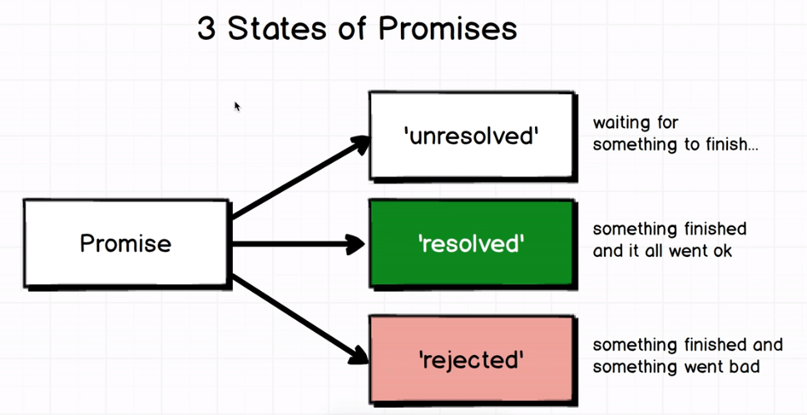
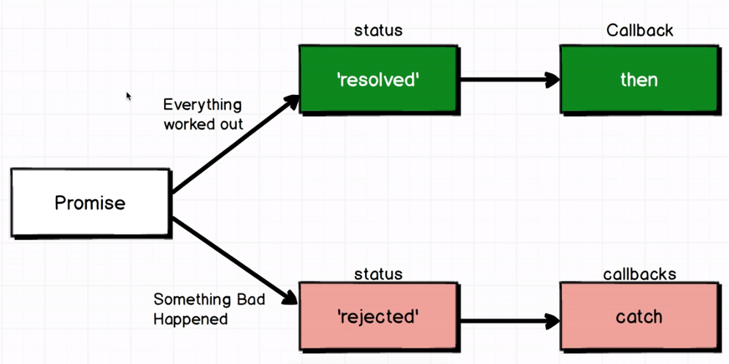
12: Promises
Demo in notes
Notes:
<script>
promise = new Promise((resolve,reject) => {
setTimeout(() => { resolve() },3000);
});
promise.then(() => console.log("finally finished"))
.then(() => console.log("finally finished2 "))
.catch(() => console.log("Catched !!"))
</script>

Slide 17
13: Proxies
Used to define the custome behavior , when a property of an object is accessed .
Syntax: let p = new Proxy(target, handler);
let handler = {
get(target, key) {
return key in target ? target[key] : 100;
}
};
let p = new Proxy({}, handler);
p.a = 1;
p.b = undefined;
console.log(p.a, p.b); // 1, undefined
console.log('c' in p, p.c) // false, 100
Demo in notes
Notes:
<script>
let handler = {
get(target, key) {
return key in target ? target[key] : 100;
}
};
let p = new Proxy({}, handler);
p.a = 1;
p.b = undefined;
console.log(p.a, p.b);
console.log('c' in p, p.c)
let validator = {
set: function(obj, prop, value) {
if(typeof value != 'number' || Number.isNaN(value)) {
console.log("Age must be a number");
} else if (value <= 0) {
console.log("Age must eb a positive number");
}
obj[prop] = value;
return true;
}
}
let person = new Proxy({}, validator);
person.age = 'young';
person.age = -70;
person.age = 75;
console.log(person.age);
</script>

Slide 18
14: Other Features
Modules
Generators
WeakMap
… to be continued with TypeScript Session.

Slide 19
References:
Exploring ES6 : http://exploringjs.com/es6/
Udemy : https://ion.udemy.com/javascript-es6-tutorial/learn/v4/overview

